Slide 1
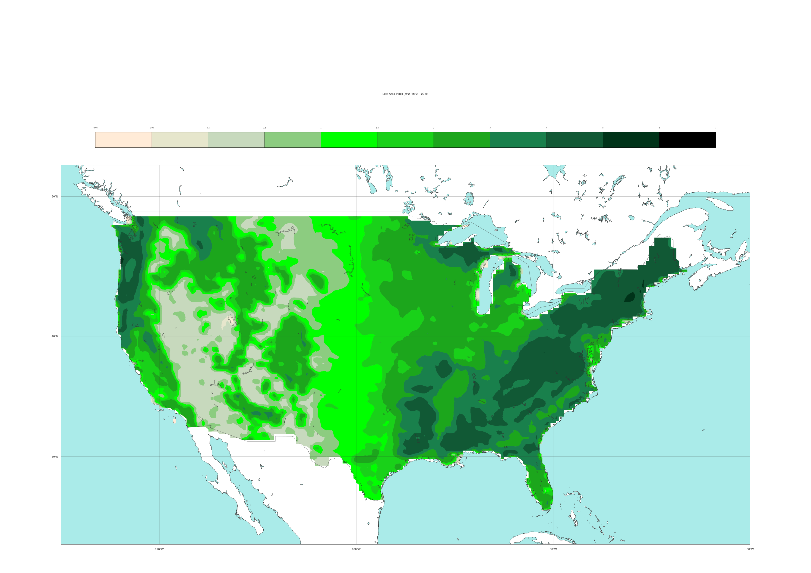
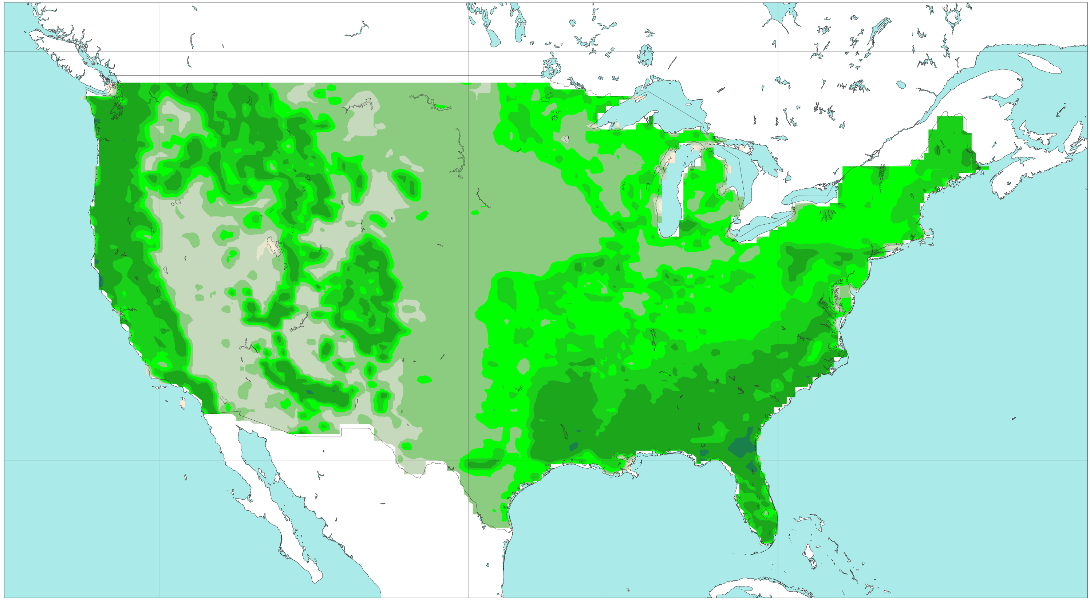
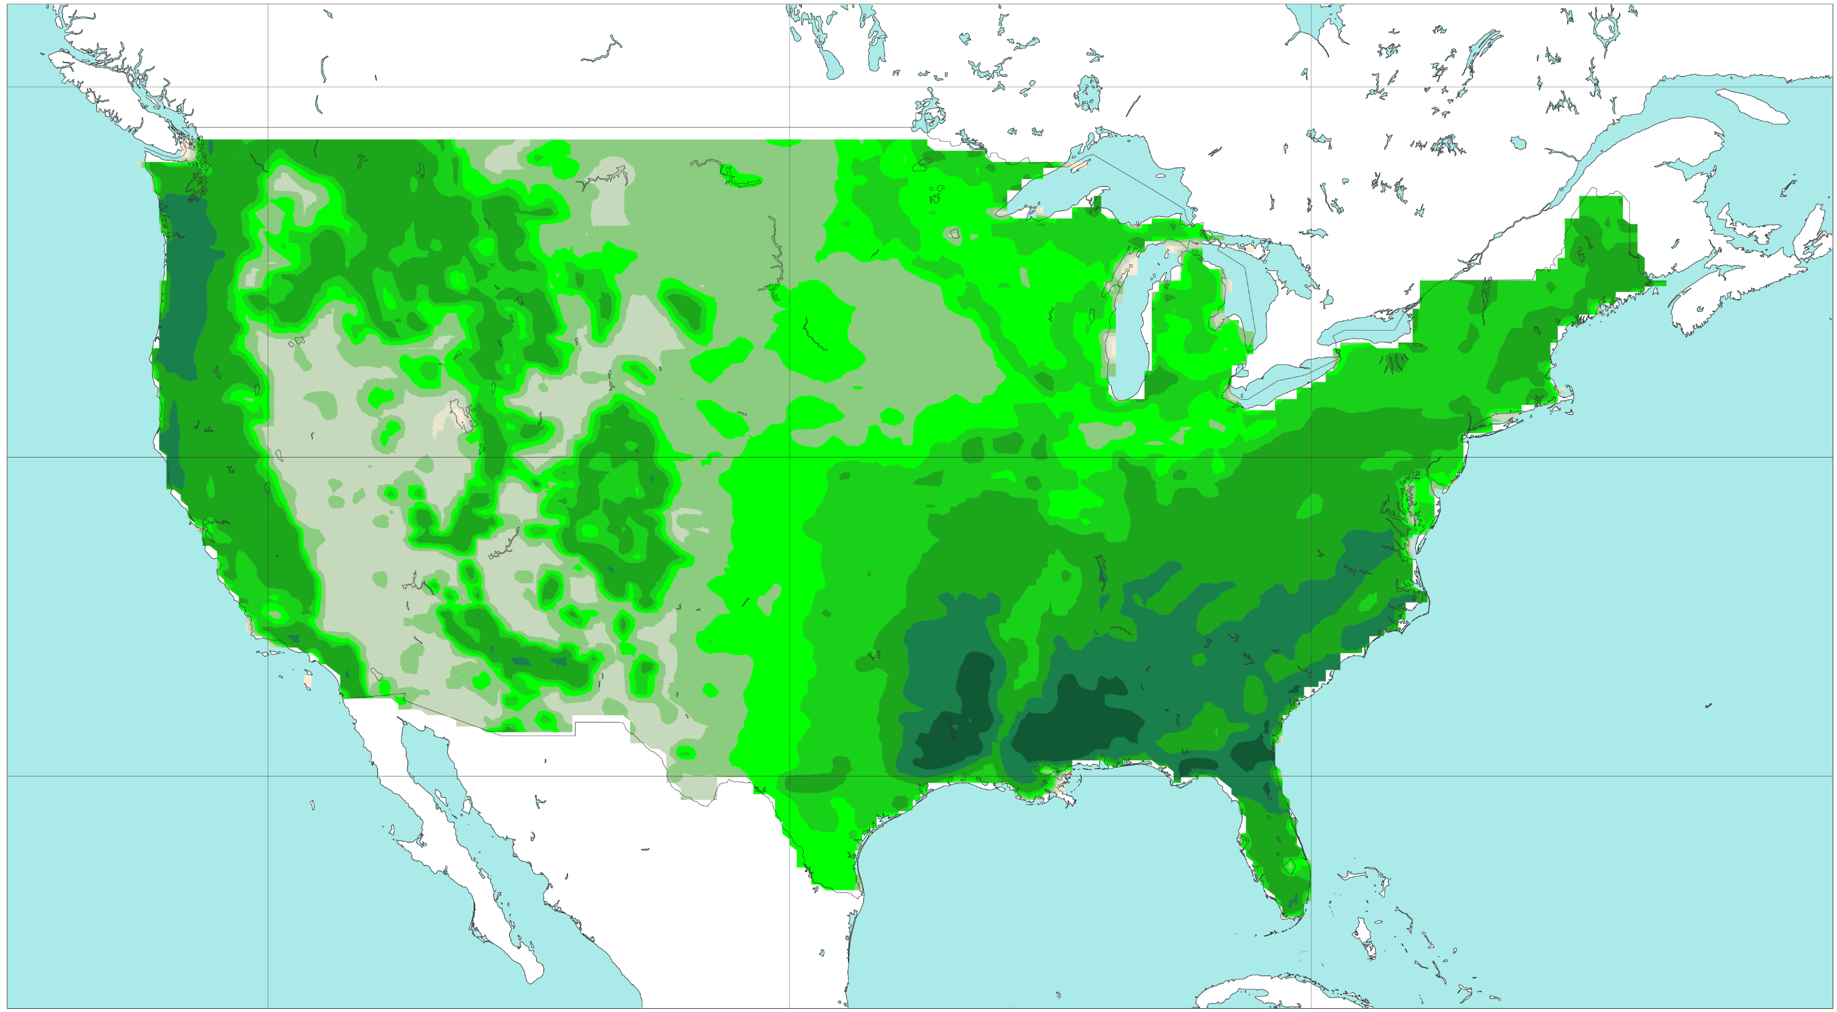
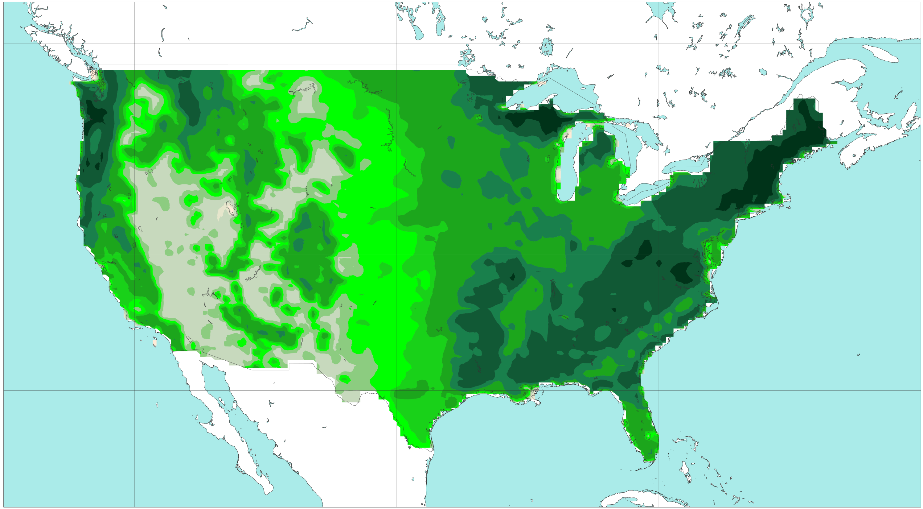
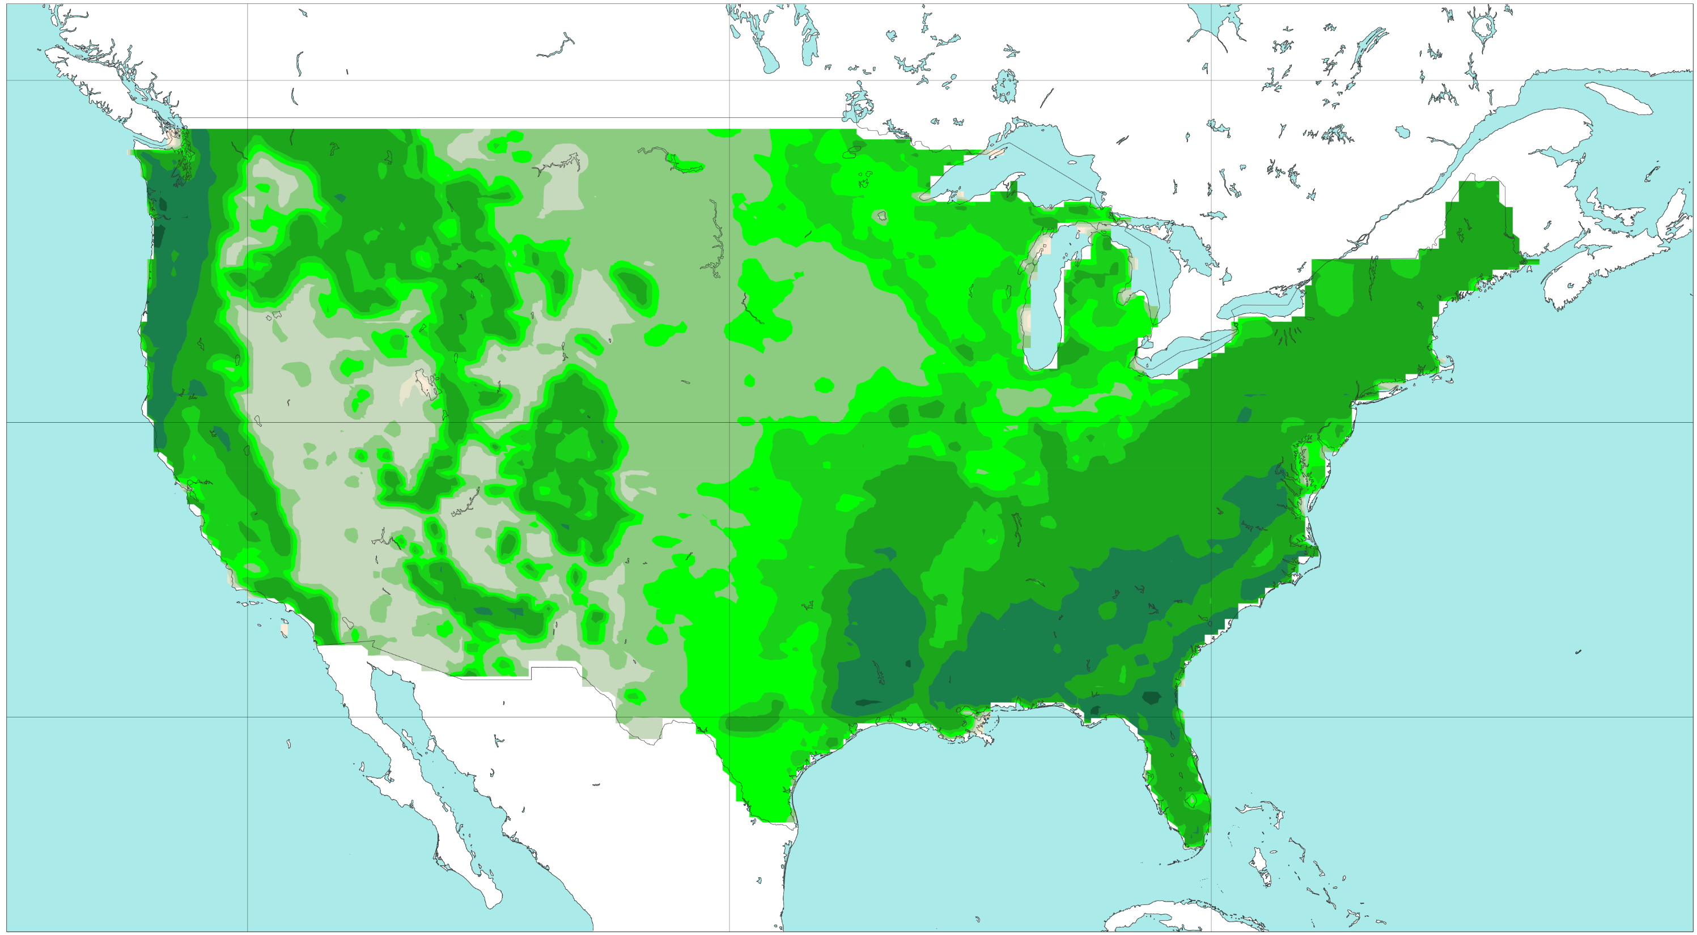
Feature variables for data-driven model
Leaf Area Index (ERA5) - Climatological field
[-]
0
0.05
0.2
0.6
1
1.5
2
3
4
5
6
7
a) 15th January (Mid-Winter)
b) 15th April (Mid-Spring)
50 °N
40 °N
30 °N
c) 15th July (Mid-Summer)
b) 15th October (Mid-Autumn)
50 °N
40 °N
30 °N
120 °W
100 °W
80 °W
120 °W
100 °W
80 °W

